Slide 1
LUNG CANCER IMAGING TOOL
A tool for medical image processing and cancer segmentation on lung-ct images
MEDICAL IMAGING
2021
Marco Peracchi- 800578
Federico De Servi - 812166

Slide 2

Topics
1) INTRODUCTION
2) IMAGE VISUALIZATION TOOL
3) IMAGE SEGMENTATION TOOL
4) CLUSTERING AND CLASSIFICATION
4) DEMO

Slide 3
INTRODUCTION

Slide 4
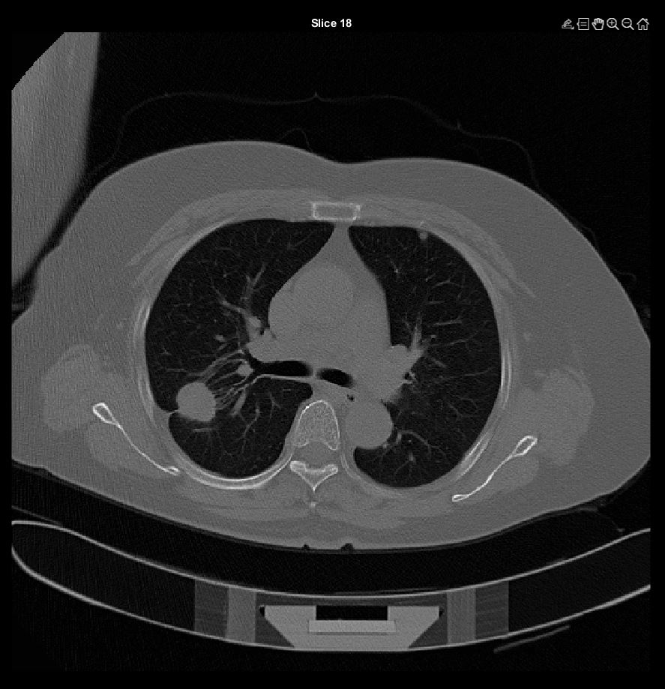
Lung cancer
Descrizione cancrino polmonino

Slide 5

Dataset
Dataset description + abbiamo tenuto solo pazienti con ct 5mm

Slide 6
The tool: overview
Patient CTs visualization
10 images overview
All images overview
Specific CT visualization
Segmentation Tool
Manual Segmentation
Ouputs volume and other relavant features
Clustering and classification
Descr veloce

Slide 7
Image visualization tool

Slide 8
CT visualizations
9 imm , tot imm, singola

Slide 9
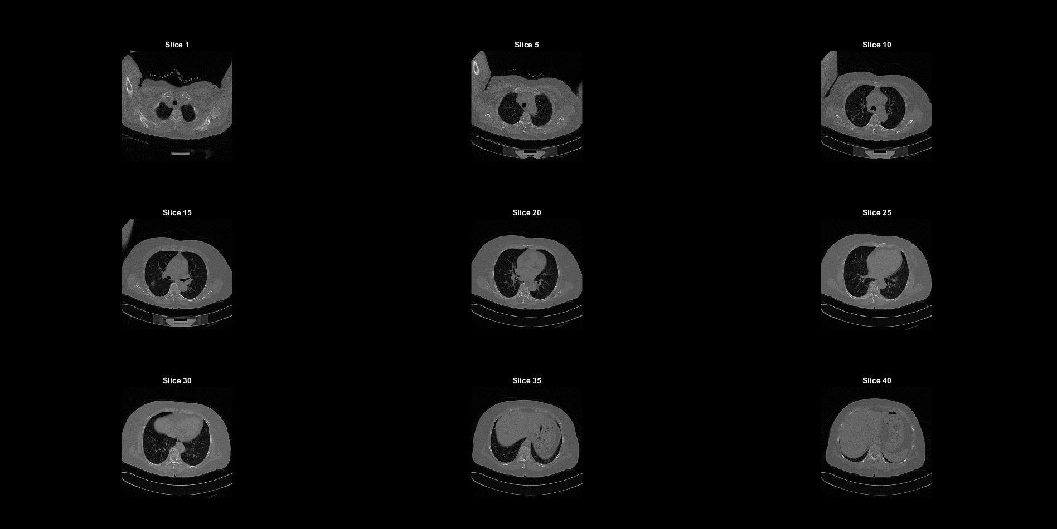
Results

Slide 10
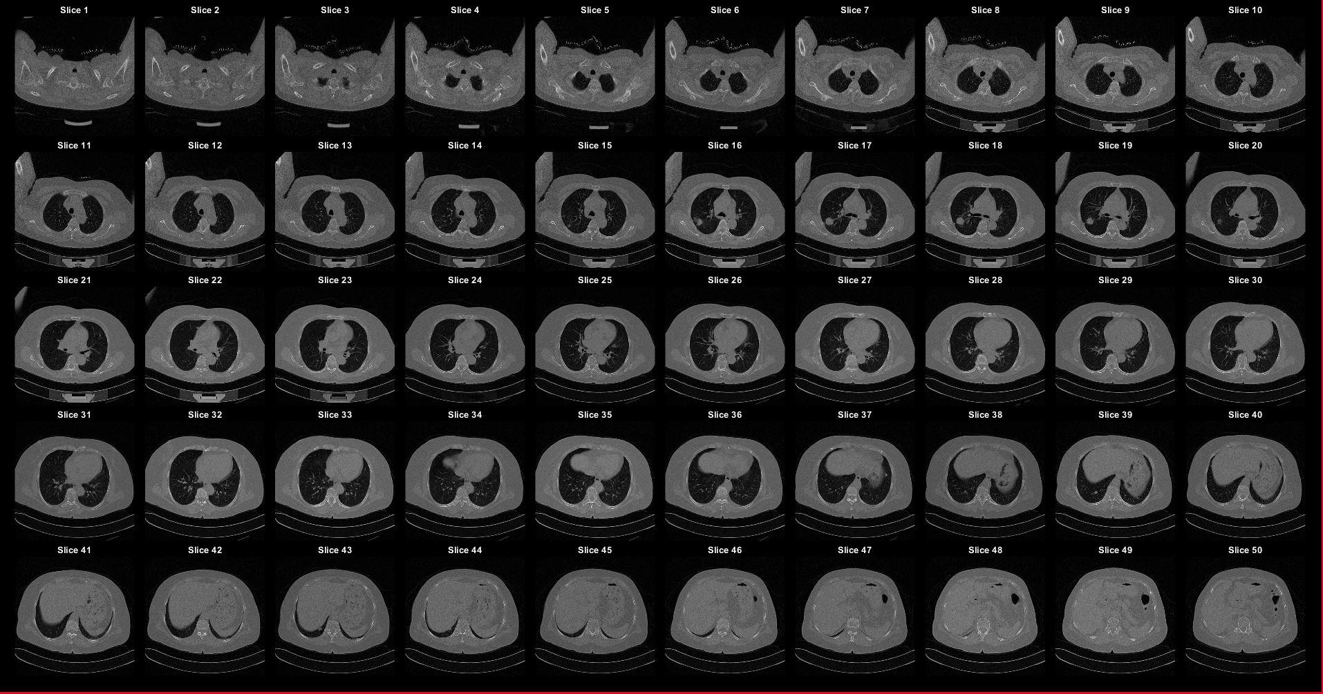
Results

Slide 11
Image SEGMENTATION tool

Slide 12
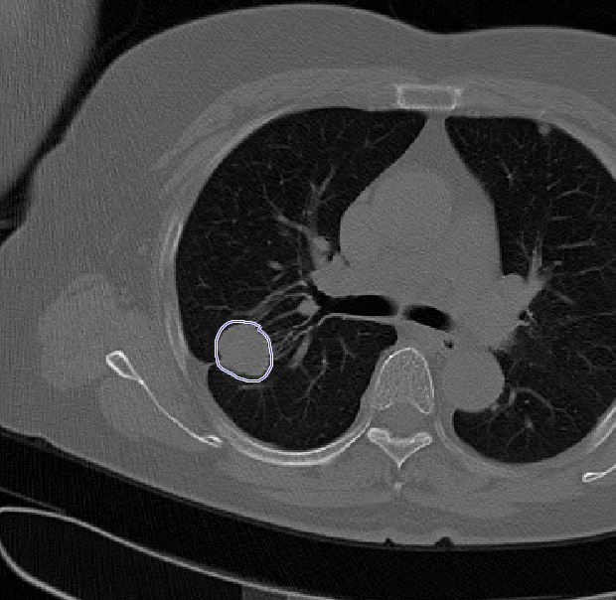
Cancer Segmentation
Spiegazione tool

Slide 13
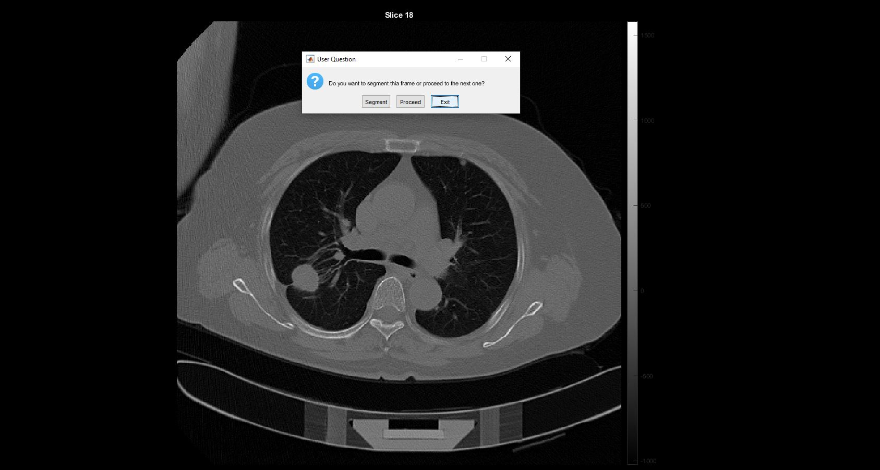
Results

Slide 14

Features extraction
Features da estrarre

Slide 15
Results
sliceNum | volumes mm3 | areas | Rs | spherical_disproportions | sphericities | surfacevolume__ratios
16 | 451,578331 | 8,218227386 | 4,759355675 | 0,028871674 | 34,63602415 | 0,018198897
17 | 1140,829468 | 26,55687256 | 6,48202508 | 0,050297413 | 19,8817381 | 0,023278565
18 | 1250,158958 | 24,6500499 | 6,682806341 | 0,043922817 | 22,76721 | 0,019717533
19 | 722,5253296 | 20,47115601 | 5,566576167 | 0,052572205 | 19,02145822 | 0,028332787
20 | 2,376728058 | 0,147397537 | 0,827872827 | 0,017114062 | 58,43148082 | 0,062016997

Slide 16
CLUSTERING AND CLASSIFICATION

Slide 17
Clustering and classification
The objective is to train a CNN model in order to classify correctly the biggest number of audio containing sounds of animals. These sounds have a lenght that ranges from 2 to 3.5 seconds and different levels of background noise.

Slide 18
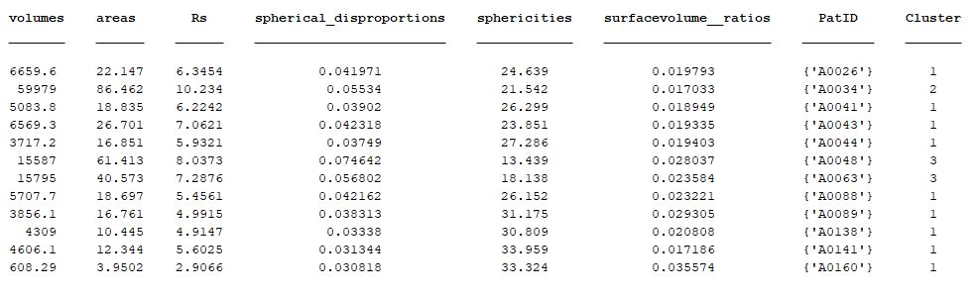
Results
Clustering

Slide 19
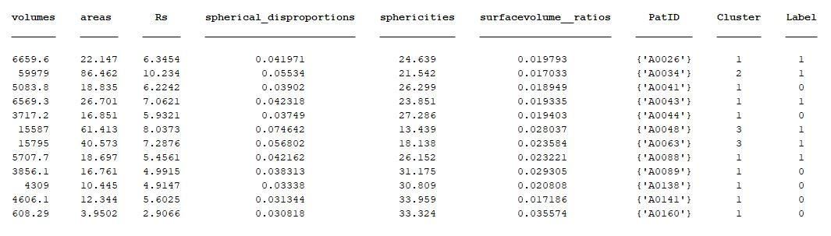
Results
Classification

Slide 20
DEMO

Slide 21

Demo

Slide 22

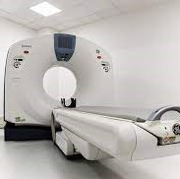
THANK YOU
Marco Peracchi- 800578
Federico De Servi - 812166

